Slide 1
Data Science
The Link Between Data and Business Value

Slide 2
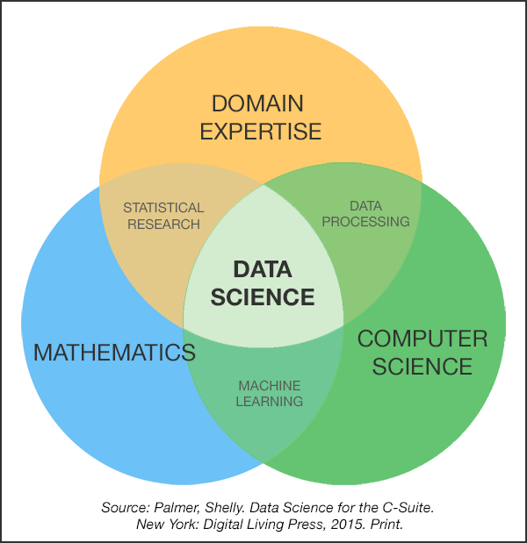
Data Science Skills

Slide 3
Hierarchy of Data Science Skills
Communication
Drives insights into action
Programming
Tools used to implement statistical concepts
Mathematics and Statistics
Concepts used to develop insights
Domain Knowledge and Expertise
Foundation of Data Science pipeline

Slide 4
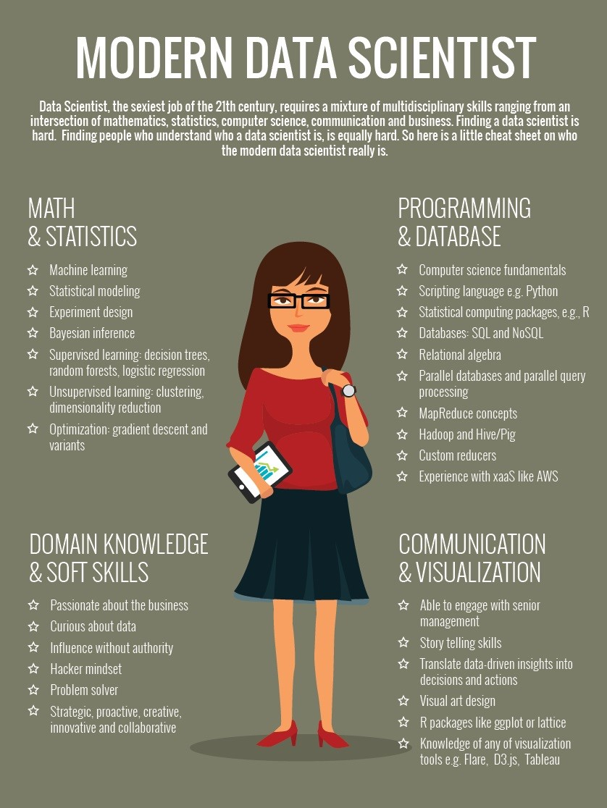

Slide 5
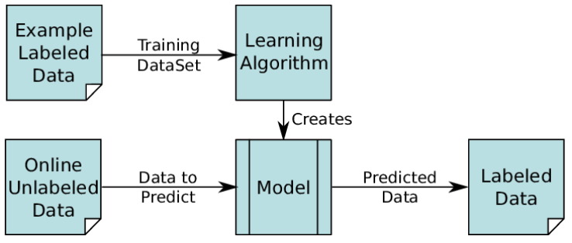
Supervised Machine Learning

Slide 6
Data Science Success Stories
NY DTF collections process modelled using reinforcement learning generated $83M more in collections the first year it was implemented
Miller, Gerard, et al. “Tax Collections Optimization for New York State.” Interfaces, vol. 42, no. 1, 2012, pp. 74–84., doi:10.1287/inte.1110.0618.
https://www.youtube.com/watch?v=bLsCuN6PQCE
Ohio DoT revamped audit selection using unsupervised? learning to increase hit rate, efficiency and equitability.
Guggenheim Partner’s Quantitative Investment Strategies Unit
Lopez de Prado, “Advances in Financial Machine Learning”, 2018.

